Slide 1
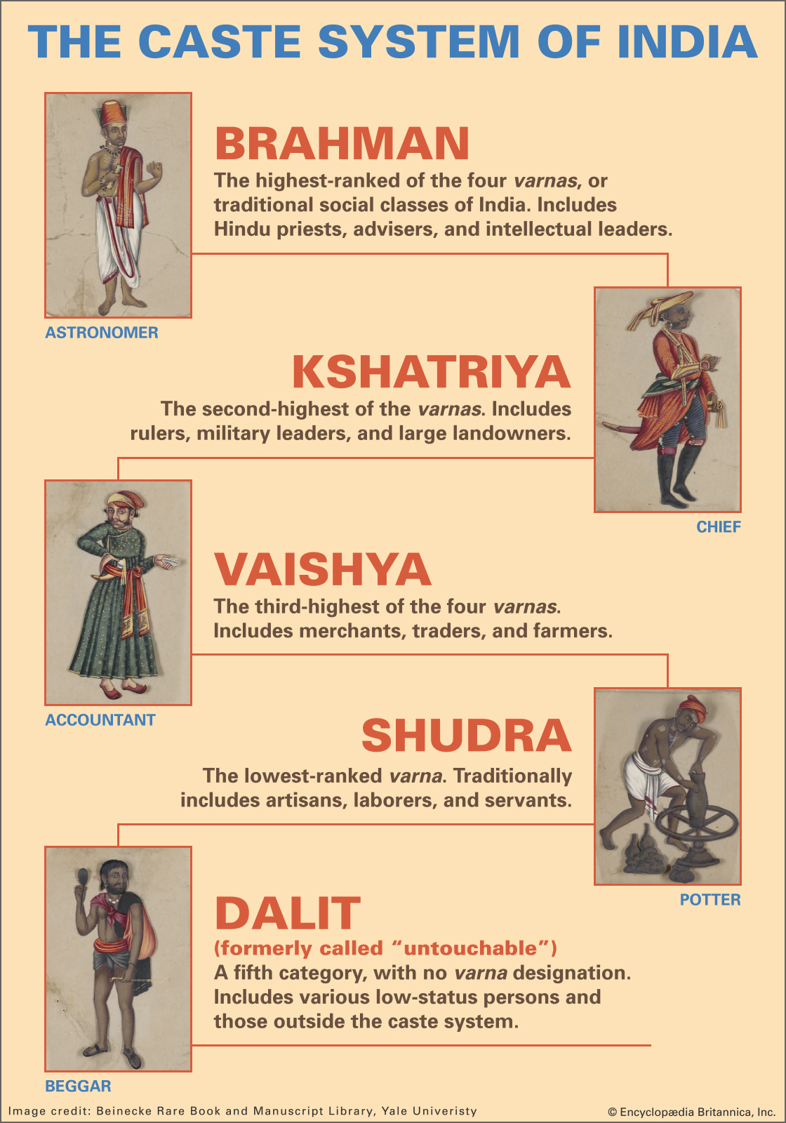
Caste, Dominant Caste and Caste Discrimination

Slide 2
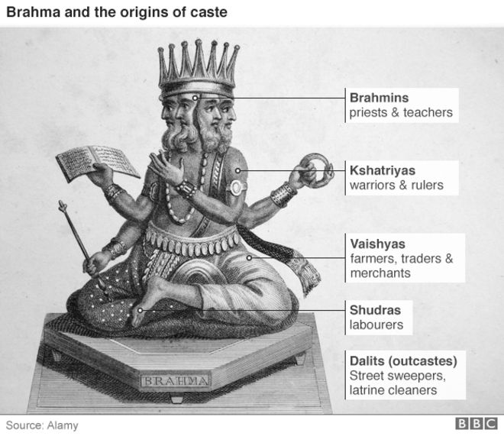

Slide 3
Caste System and its characteristics
Celestin Bougle finds caste as a system that divides the whole society in large number of hereditary groups, distinguished from one another and connected through three characteristics:-
Separation – matters related to marriage and contact whether direct or indirect (food)
Division of labour – each group has in tradition or theory, a profession from which their members can depart to a certain extent
Hierarchy – which ranks the groups as relatively superior or inferior to one another
‘Caste’ has Portuguese and Spanish origin – Casta seemed to be used in the sense of race by the Spaniards and to have been applied to India by the Portuguese in the middle of 15th century

Slide 4
Caste System and its characteristics
Endogamy – Caste System is a hierarchy of endogamous groups that individuals can only enter by birth
Compelling religious sanctions – Varna Ashrama Dharma – where varna means color, ashram means religious discipline and dharma covers religio-social righteous obligations and mores
Marriages outside caste was prohibited, eating and drinking with an outsider, from touching an outcaste, eating unclean food, etc
Hierarchy based on birth and reincarnation – Each caste stands on the shoulder of other caste
Socio-economic interdependence – Fixed social status established by birth. Ex- carpenter family
The Outcaste substratum – Menial and defiling drudgery performed for him by the outcaste, depressed classes or untouchables

Slide 5
M.N. SRINIVAS – “DOMINANT CASTE”
In 1953 – through his study of Rampura Village (multi-caste village) Srinivas came up with the idea of “dominant caste”.
Dominant caste – numerically, economically and politically.
1950s – Srinivas came up with the idea of “ Western” – where an educated person by gaining the Western or non-traditional means of education can occupy a dominant position in the caste.

Slide 6
M.N. SRINIVAS – “DOMINANT CASTE”
Caste which occupies a dominant position in the caste hierarchy by having all the elements of dominance is seen as dominant in a decisive way.
This form of dominance is not common.
In the study of Rampura Village, Srinivas found that the Peasant (Okkaligas) caste enjoyed more than one element of dominance (numerically, economically and educationally).

Slide 7
M.N. SRINIVAS – “DOMINANT CASTE”
In the study of Rampura Village, Srinivas found that the Peasant (Okkaligas) caste were numerically dominant – with 735 members; biggest landowners as peasants together own more land than all other castes put together; more literate men among peasants than other castes
The ritual rank of the peasants is not very high, and they belong to the Shudra caste but they commanded respect from the priestly castes like Lingayats and Brahmins as they were the dominant caste in Rampura
The Brahmins were the first to sense the new economic opportunities opened to them through Western education, and they gradually moved to the towns to enter the new white-collar professions.
Urban living, the cost of educating children, and the high dowries which the new education and economic opportunities had brought about, gradually caused the Brahmins to part with their land. Much of this land passed to non-Brahmins, especially the Peasants, during the years 1900-1948. This led to the large scale landholding among the peasants in Rampura

Slide 8
Non-Brahmin Movement
At the end of the World War I – non-Brahmin leaders also realised that they must get Western education to get important positions and power in the Government of Mysore.
Agitation started – institutionalisation of the scholarship, reservation of seats in medical and technical colleges and appointments to government posts.
The non- Brahmin agitation succeeded, and gradually a number of rules discriminating against the Brahmins were evolved by the Government of Mysore.
Agitation succeeded and the measures led to Western educated non-Brahmin intelligentsia in the 1930s.

Slide 9
Non-Brahmin Movement
This non-Brahmin movement is relevant to the understanding of the situation in Rampura. It was in the thirties that the leaders among Peasants in Rampura and the neighboring villages began to think of higher education for their sons.
Contact between the Peasants in Rampura and Peasant politicians and officials outside increased in the forties; furthermore, contact with the towns increased generally, and a few Peasants and Lingayats frequently went to Mysore and Bangalore to secure permits and to buy machinery and other goods.
These increased the chances of the Peasants to become dominant in decisive way.

Slide 10
Non-Brahmin Movement
But when a caste enjoys one form of dominance, it is frequently able to acquire the other forms as well in course of time.
Thus, a caste which is numerically strong, and wealthy will be able to move up in the ritual hierarchy if it Sanskritizes its ritual and way of life, and also loudly and persistently proclaims itself to be what it wants to be.
This applies only to caste Hindus. Untouchability constitutes a serious obstacle to the group mobility.

Slide 11
Caste Discrimination and Group Mobility
Untouchables in Rampura are either landless laborers, tenants, or very small landowners. They started going to school only in the thirties.
In 1948 – Untouchable leaders outside villages (Bihalli) asked the untouchables in the Rampura village to stop performing services such as removing the dead cattle from the higher caste, removing leaves on which the high caste had dined, etc.
In the neighboring village of Bihalli, for instance, Untouchables decided to give up performing services such as removing the carcasses of dead cattle from the houses of the higher castes, beating the tomtom at the festivals of village deities, and removing the leaves on which the high castes had dined during festivals and weddings. The Bihalli Peasants became annoyed at this and beat up the Untouchables and set fire to their huts.
A similar attempt by the Kere Untouchables was also made unsuccessful by the local Peasants

Slide 12
Caste Discrimination and Group Mobility
In Rampura 1948 - the Government of Mysore sanctioned a sum of money to enable Untouchables in Rampura to have tiled roofs instead of thatch – the Untouchables claimed that they did not get readily from the Headman.
The Peasants, on the other hand, said that the Untouchables had spent the money given to them on toddy, and that this showed that Untouchables could not be improved.
The dominant caste in both the cases were opposed to the emancipation of the Untouchables.

Slide 13
Caste Discrimination and Group Mobility
While the Governments of India and Mysore want to abolish Untouchability, and the Untouchables themselves want to improve their position, the locally dominant caste stands in the way; its members want the Untouchables to supply them with cheap labor and perform degrading tasks
The dominant caste also resent the idea that Untouchables should use their wells and tanks, and worship in their temples. They have the twin sanctions of physical force and boycott at their disposal.
It is true that the Untouchables can enforce their rights with the aid of the Police and Law Courts, but there are many considerations which come in the way of taking such a drastic step.

Slide 14
Different Caste Restrictions
According to Srinivas - the same caste may occupy different positions in neighbouring villages and no two caste are identical.
For instance, in Kere village, Fishermen were not allowed to take their wedding and other processions into streets in which Brahmins and Peasants lived, whereas in Malavalli Taluk villages where Fishermen were in the majority, no such disabilities affect them.
When the same caste occupies different positions in different villages, the segment of the caste which is occupying the lower position will be stimulated to move up in the local hierarchy.

Slide 15
Different Caste Restrictions
Srinivas visited Kere a few times during the summer of 1952 and found that the Brahmins there were suffering from a sense of insecurity.
In the General Elections held a few months previous to his visit, the members of the family of the Brahmin accountant had actively canvassed for a candidate who was not residing in Kere. This enraged the local candidate, a very powerful Peasant.
The outsider won and the defeated candidate freely expressed his dislike of Brahmins in general and the accountant’s family in particular. He even said that he wanted the Brahmins to leave Kere.
A Brahmin doctor in Kere told Srinivas that Brahmins had no future in the village where they were few in number. He thought that Brahmins ought to migrate to villages and towns in which they were represented in some strength.

Slide 16
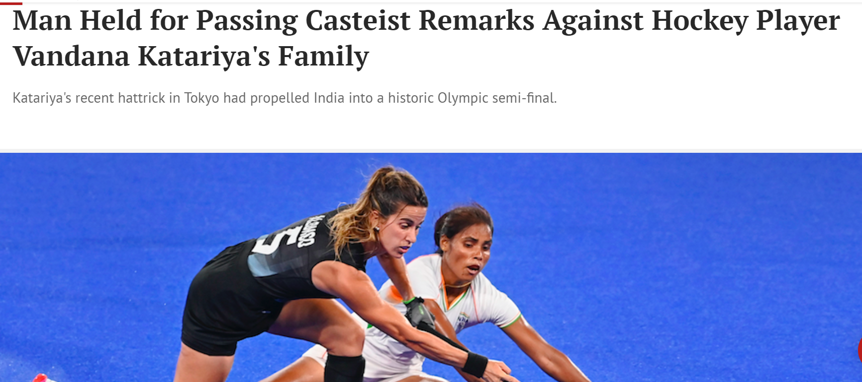

Slide 17

Caste in the 21st Century
Caste as a Status Hierarchy
Caste system brings in social system of super ordination and subordination.
In Urban India – purity and pollution are difficult to maintain.
There might be differences existing among different castes but if it translates to social hierarchy is still a question.
Over time rituals and food habits of different castes have also seen a decline.
Caste as a System of Exclusion and Exploitation
Centuries of caste-based social organisation have left a legacy of inequality in access to land, education, business ownership and occupation.
Two aspects of caste inequalities deserve attention: inequality of opportunity and inequality of outcome.

Slide 18
Caste in the 21st Century
Caste in Transformation
Before independence many castes, and probably most, had more than half their working members in occupations other than those specifically associated with their caste
In an independent India the link between caste and occupation has weakened considerably.
Politics of affirmative action has further strengthened the power of lower castes with reservations in government jobs and higher education (Beteille 1992).

Slide 19
Overview of the Caste System
This idea of the dominant caste is an important development in tracking the evolution of the understanding of lived caste.
In contrast to the traditional view of Brahmins as superior regardless of material or numerical strength, Srinivas (1987) coined the term dominant caste to refer to those who were considered more locally dominant because of their numerical or material socioeconomic strength, regardless, to a certain extent, of their ritual purity.
Caste which was regarded as hierarchical and immobile groups – contested.

Slide 20
Overview of the Caste System
Caste is also a political construct in India.
The Indian Constitution recognizes three broad groups for its affirmative action or reservation policies.
The Scheduled Castes (SCs, a listing of predominantly ex-untouchable jatis).
The Scheduled Tribes (STs, a listing of geographically isolated groups) were identified via a schedule in the Indian Constitution in 1950 as groups deserving of preferential treatment in light of historical discrimination and disadvantage.
The third group, called the Other Backward Classes (OBCs), received reservations in the 1990s after much contentious debate and violence.
The definition of OBCs is more complex, as they are technically not simply castes or jatis, but classes.

Slide 21
Overview of the Caste System
Officially, however, the central listing of OBCs includes castes and communities considered socially, economically, or educationally “backward” by the National Commission for Backward Classes.
Ex - OBCs include groups of jatis such as the Yadavs (originally a caste of cowherds) in states such as Rajasthan and Uttar Pradesh.
They form the “bulk of the Shudras— the fourth category (varna) of the classical Hindu social arrangement” ( Jaffrelot 2000, p. 86), while the ex-untouchables form the bulk of the SCs.
SCs, STs, and OBCs receive a particular number, in proportion to their population, of reserved seats in the public sector, educational institutions, and some legislative institutions (see Galanter 1984; McMillan 2005, Srinivas 1996).

Slide 22
Overview of the Caste System
Critics of these reservations have argued that it solidifies caste identity, whereas supporters have emphasized the need for corrective procedures to help these castes overcome centuries of oppression and discrimination (Srinivas 1996a).
Caste can be understood in many ways, but the constitutional categories of SC, ST, and OBC arguably have a greater importance in the political domain and with regard to affirmative action.
Caste is not restricted to Hindu society nor to communities in India alone. Caste exists in a variety of forms in other religions in India, leading to a hierarchy of ritual status in these religions as well [for castes among Muslims, see Ahmed (1978), Bhatty (1996), and Fanselow (1996); for castes among Christians, see Tharamangalam (1996)].

Slide 23
Overview of the Caste System
A recent study on “caste and discrimination” in four South Asian countries—Pakistan, Nepal, Sri Lanka, and Bangladesh by Jodhka and Shah (2010) —underscores the existence of caste and caste-like discrimination outside of India.
Jodhka and Shah (2010) report through their fieldwork in these 4 countries that -
“even when meanings of untouchability or even its sources (religion or tradition) vary across regions, as also its forms, from physical touch and residential segregation to taboos and restrictions on inter-dining, physical movement or pursuing occupations of one’s choice, its effects on those placed at the bottom are quite similar, viz. economic deprivation, discrimination and a life full of humiliation” ( Jodhka & Shah 2010, p. 2)

Slide 24
Overview of the Caste System
Furthermore, research among the Indian diaspora has highlighted the persistence of caste, especially in social relationships and religious practice (Borbas et al. 2007, Kumar 2004, Metcalf & Rolfe 2010).
For example there are certain Gurudwaras or Sikh places of worship in the United Kingdom that are frequented by low-caste Sikhs only.
In light of the Indian government’s policies to redress the inequalities suffered by the backward castes and tribes, Sanjay Kumar, Anthony Heath and Oliver Heath (2002) set out to study whether these political and social movements have made India a more mobile society in the past five decades. In their first paper (2002b), they lay out the trends in mobility of men, and in the second (2002a), they study the determinants of this mobility.

Slide 25
Overview of the Caste System
Using the 1971 and 1996 male-only National Election Study (NES) data (a large, individual level, nationally representative data set), they conclude that “there has been no systematic additional weakening of the links between father’s and son’s class positions, or between caste and class” (Kumar et al. 2002a, p. 4096).

Slide 26
Overview of the Caste System
The role of castes as interest groups in the political arena has also been a subject of many debates and is another indicator of the adaptive nature of caste ( Jaffrelot 2012, Shah 2004).
For instance, the Bahujan Samaj Party, which has gained popularity in Uttar Pradesh and other northern states, is an example of a party geared specifically to those at the margins.
Srinivas (1962, p. 5) suggests that “for purposes of sociological analysis a distinction has to be made between caste at the political level and caste at the social and ritual level”.
In sum, the caste system has clearly evolved and adapted to socioeconomic and political changes. Whereas some of its characteristics remain intact.

Slide 27
Overview of the Caste System
Characteristics like (such as practicing pollution) are slowly, although not entirely, disappearing from the public sphere, others (such as voting on the basis of caste identity) have led to caste becoming a part of contemporary political language.
Caste has evolved over time but has been quite resilient as an institution and has not disappeared altogether.

